Slide 1

Heart Failure Prediction Using Machine Learning
Anthony Costa, Jonathan Diaz, Sarah Kim, Aakash Nagalapura

Slide 2

Heart Failure Prediction Dataset
Source: The dataset is a combination of 5 independent sets combined over 11 common features
Cleveland: 303 observations
Hungary: 294 observations
Switzerland: 123 observations
Long Beach, VA: 200 observations
Stalog (Heart): 270 observations
The 11 features:
Age of the patient
Sex of the patient
Chest pain type
Resting BP
Cholesterol
Fasting Blood Sugar
Resting ECG
Max Heart Rate
Exercise-Induced Angina
Oldpeak
ST Slope
Heart Disease

Slide 3
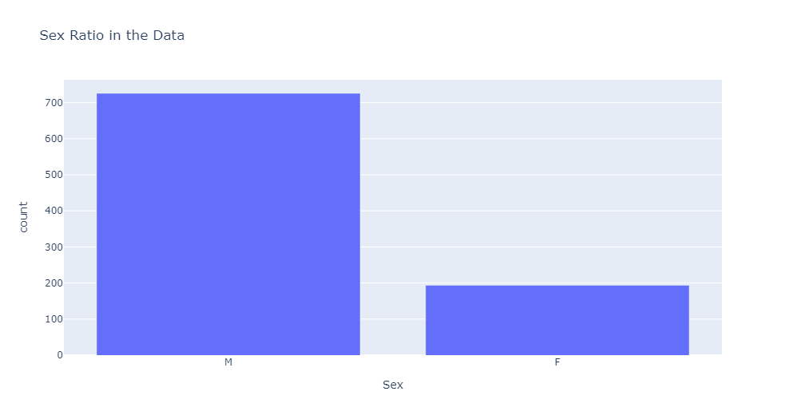
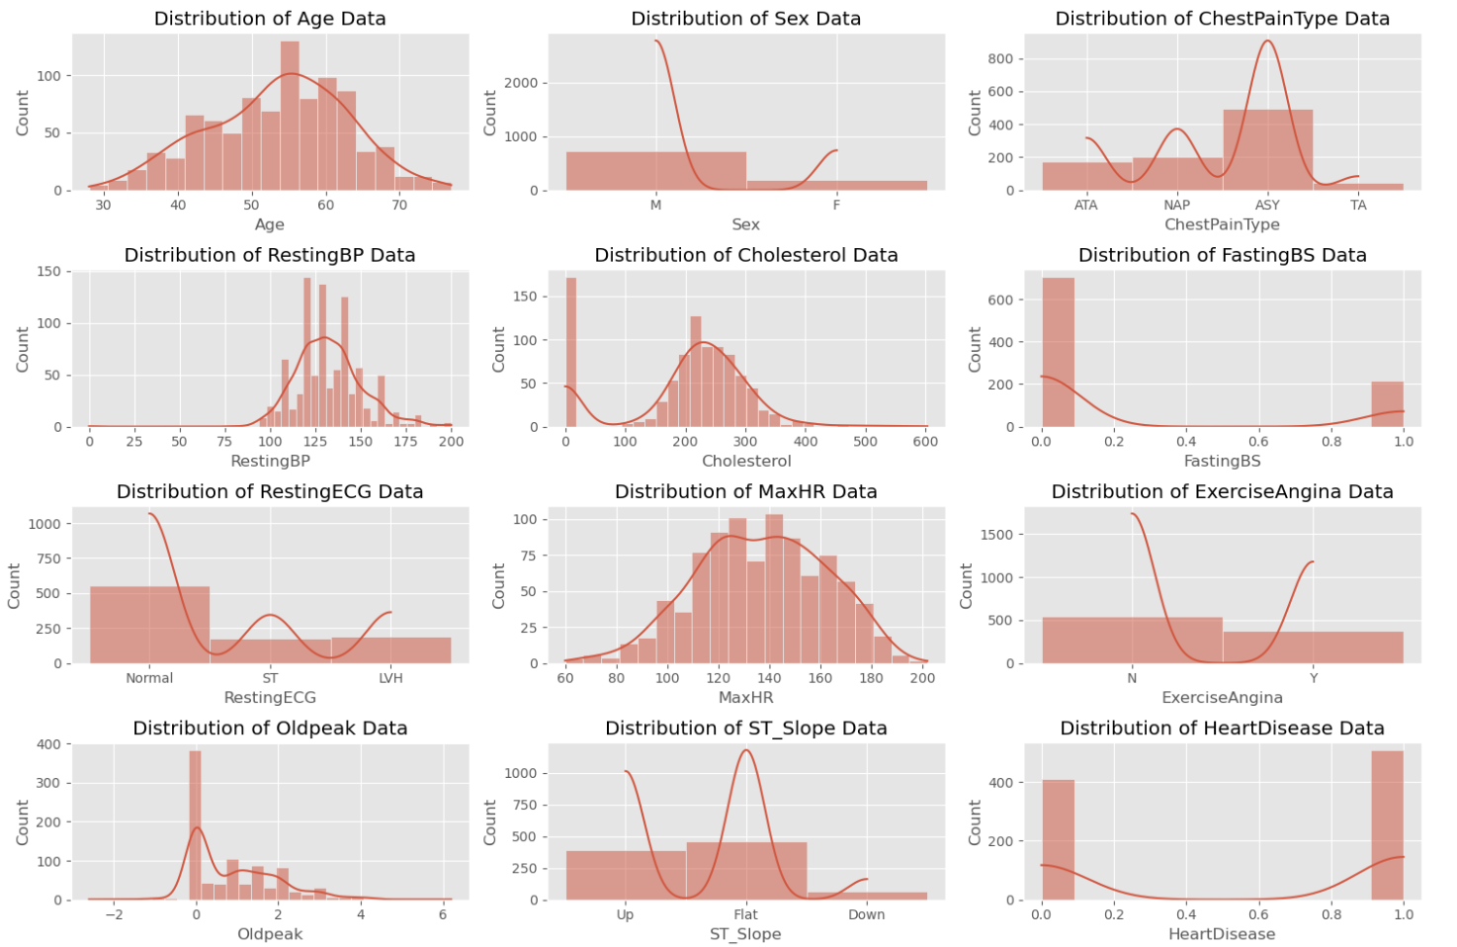
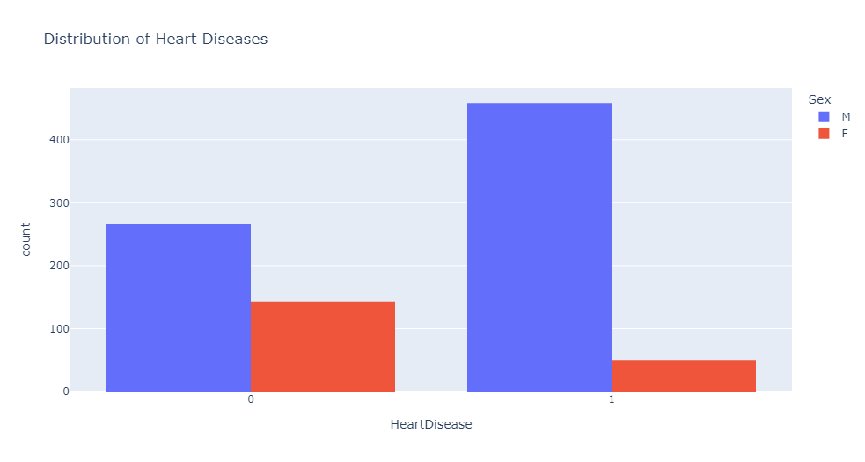
Trends in the Dataset
Caption
Caption
Caption

Slide 4
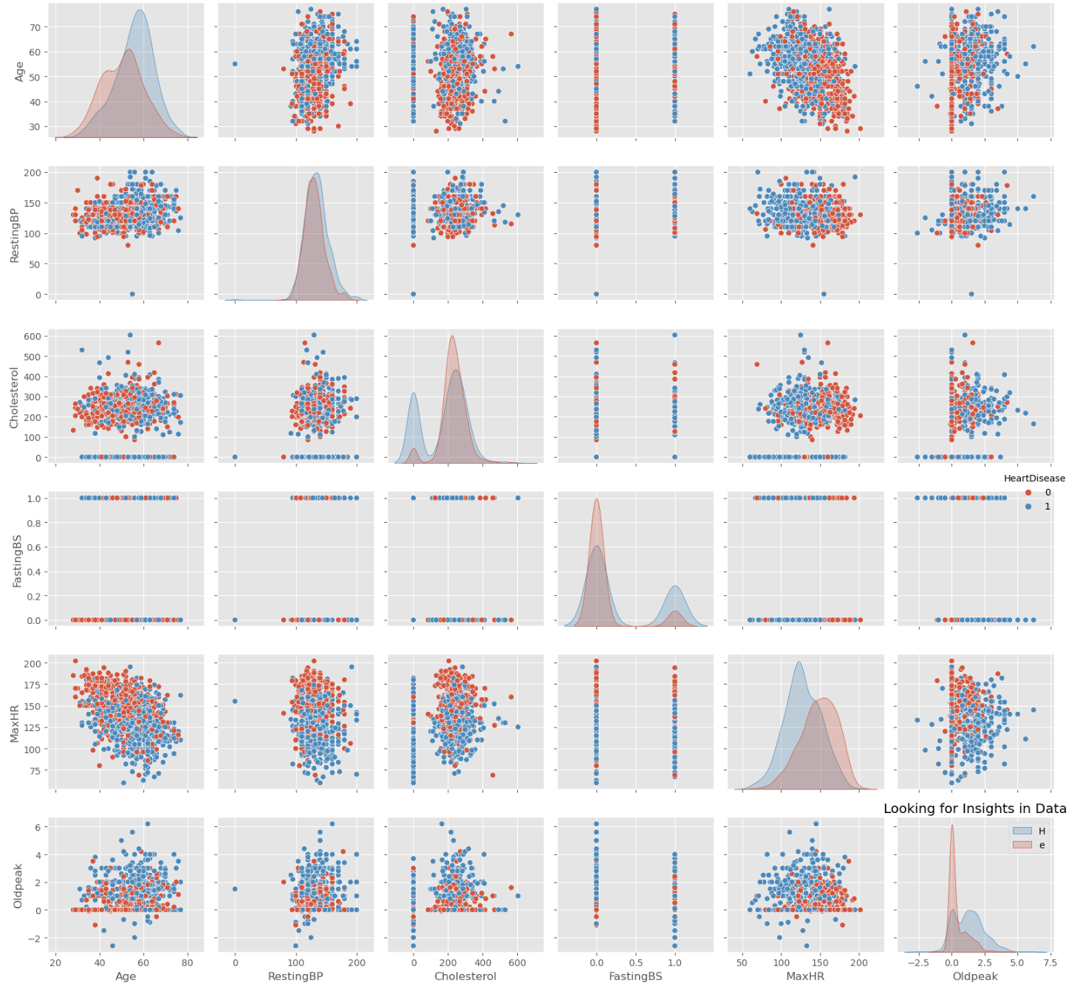
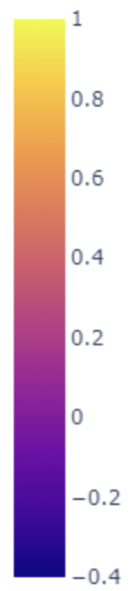
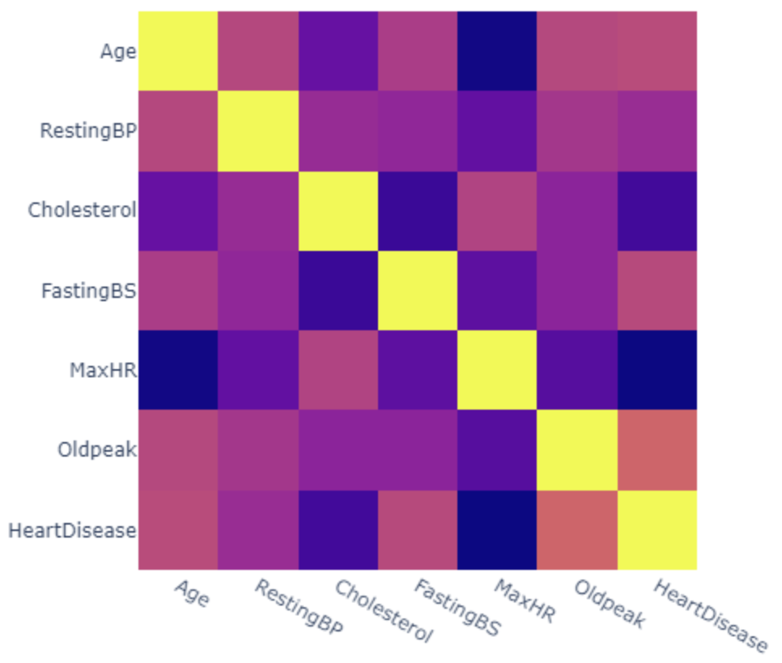
More Trends..
Caption

Slide 5
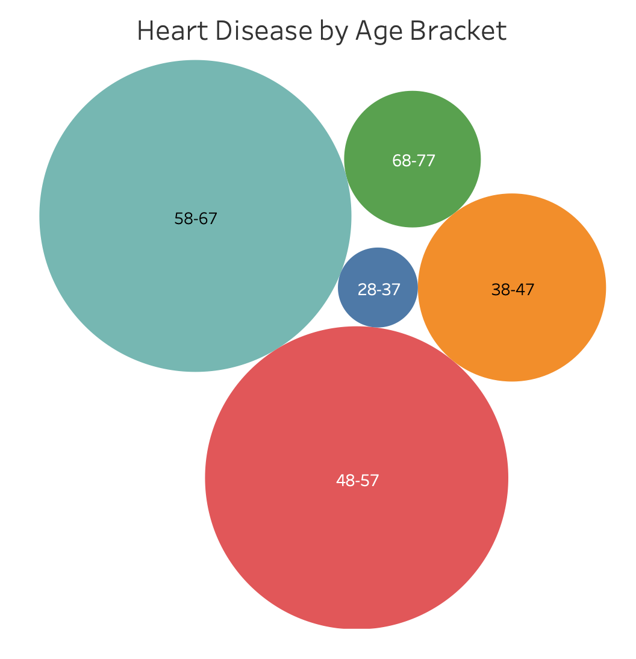
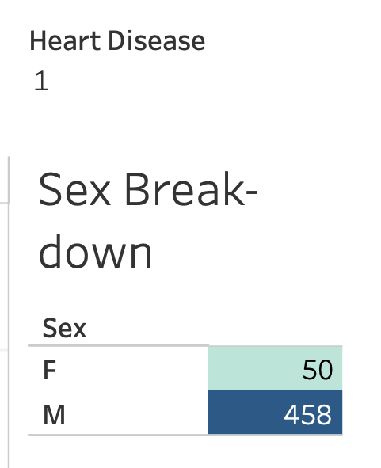

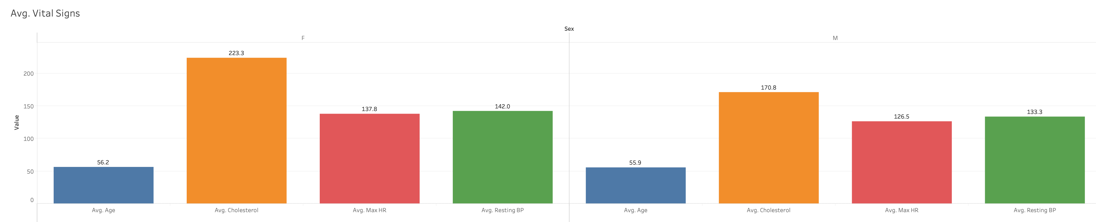
General Overview
More data from male patients
Highest number of cases for patients in the mid-50’s age range
Tableau

Slide 6
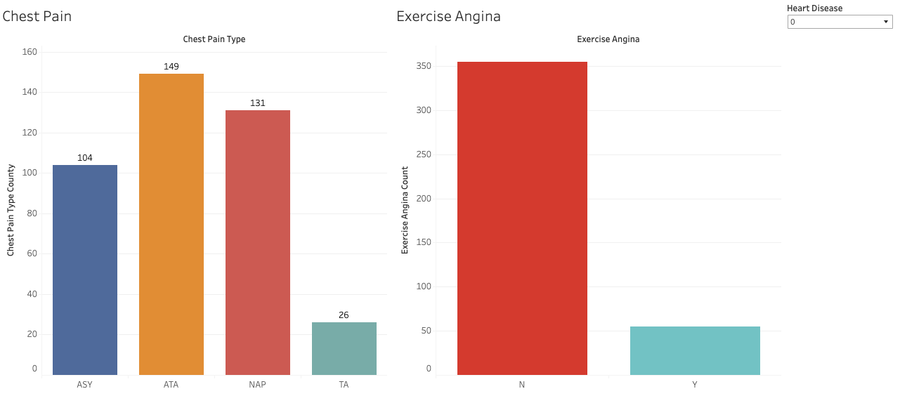
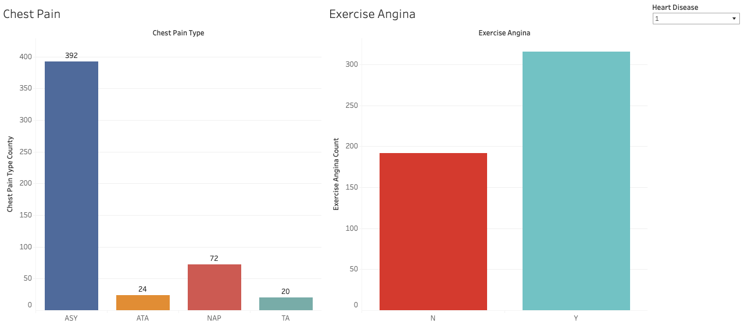
Exercise-Induced Angina
We see different patterns in patients that test positive for heart disease compared to those that do not.

Slide 7
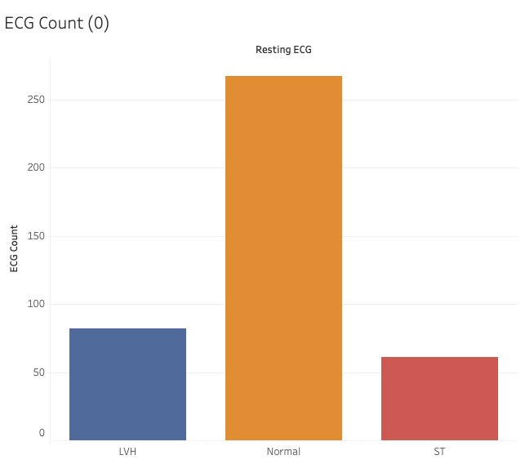
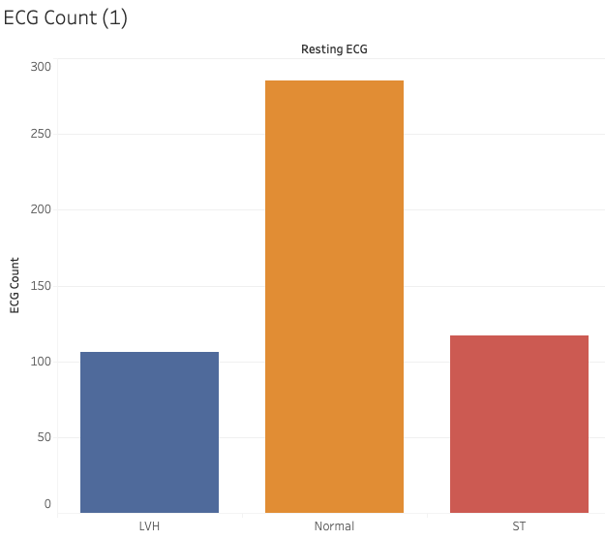
Resting ECG

Slide 8
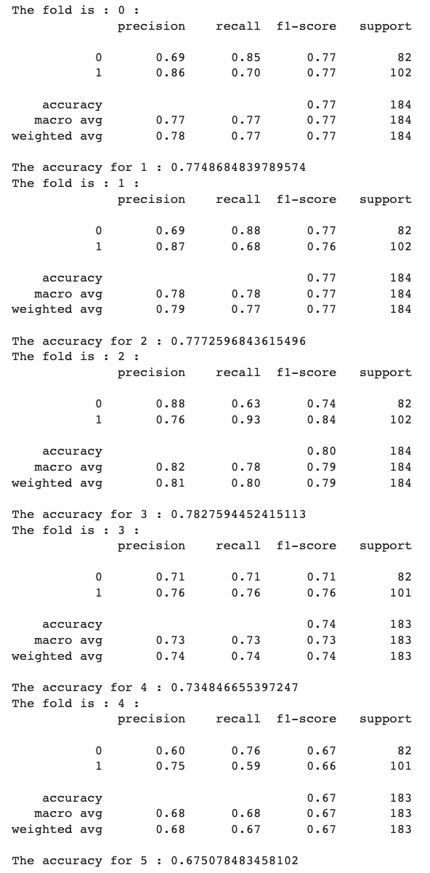
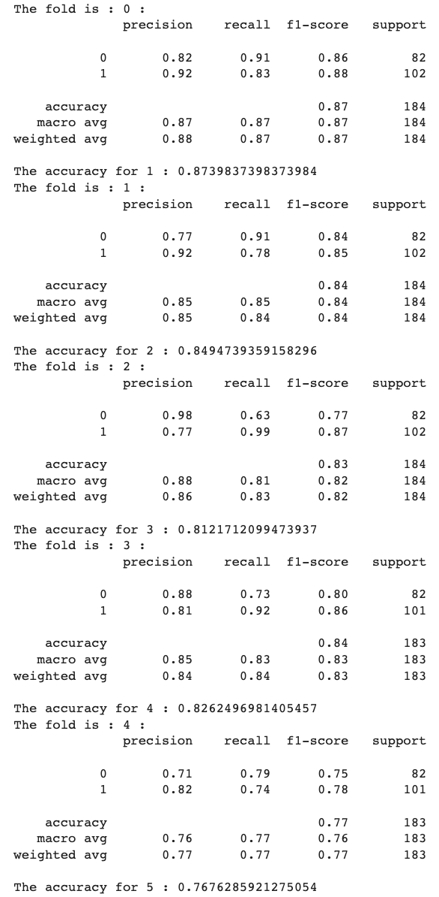
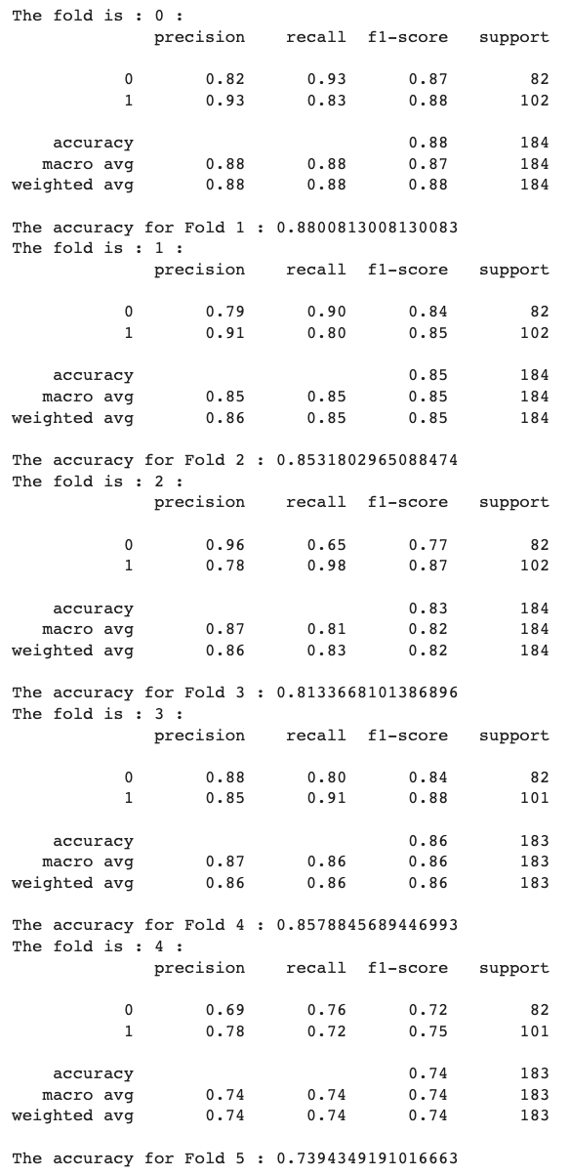
Finding the Right Model..
Decision Tree
Random Forest
Logistic Model

Slide 9
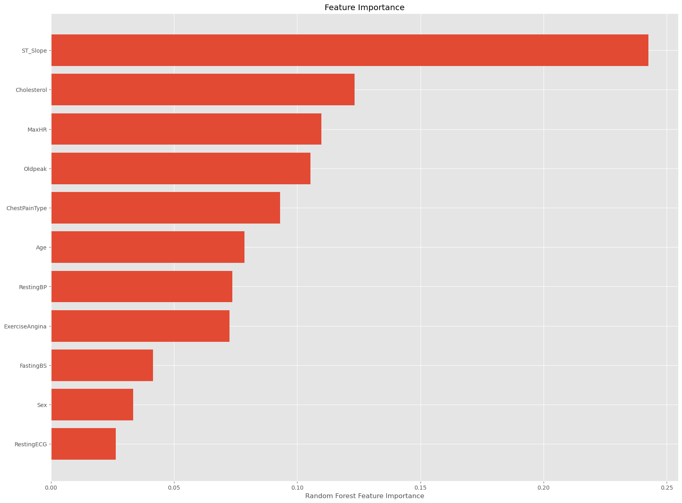
Feature Importance
Caption

Slide 10
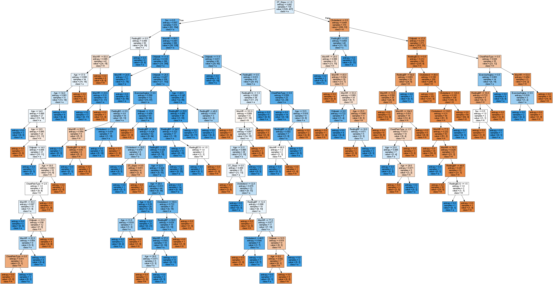
Decision Tree

Slide 11

Limitations
Limited number of observations - only 1000
Comorbidity
No specific time frame
Caption

Slide 12

Any Questions?
Caption

Slide 13
Thank you!!

